Slide 1
Nuclear Weapons General Information Moral Issues Survivors’ Stories
Brought to you by
Testimonies filmed by Soka Gakkai International

Slide 2
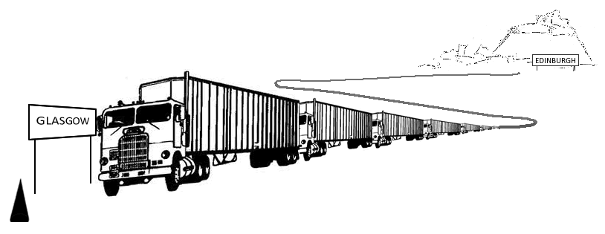
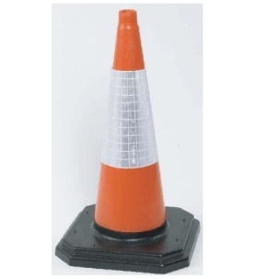
WHAT ARE NUCLEAR WEAPONS?
Bombs that use nuclear energy to cause an explosion.
Nuclear energy is created when we split
the atom.
A nuclear bomb is the size of a large traffic cone.
It would take 3,300 lorries to carry high explosives with as much destructive power as one nuclear bomb!
Notes:
*Atoms are tiny particles that make up every object in the universe. Nuclear energy is energy in the core of an atom. There is enormous energy in the bonds that hold the nucleus together. Energy is released when those bonds are broken.

Slide 3
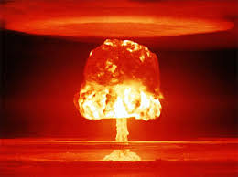
WEAPONS OF MASS DESTRUCTION ( W M D )
Weapons that can kill and bring significant harm to a large number of humans
Weapons that cause great damage to human-made structures, natural structures, the environment or the biosphere
Other examples of WMDs include chemical weapons and biological weapons.
Notes:
*Atoms are tiny particles that make up every object in the universe. Nuclear energy is energy in the core of an atom. There is enormous energy in the bonds that hold the nucleus together. Energy is released when those bonds are broken.

Slide 4
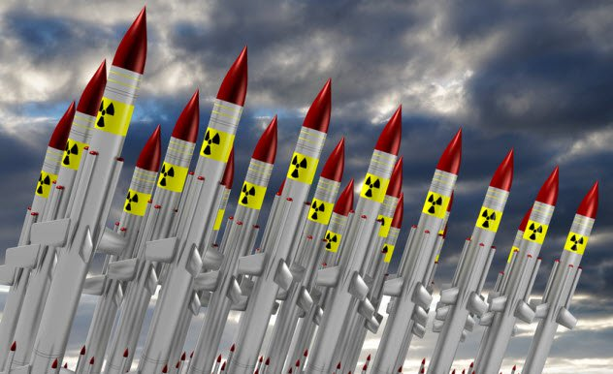
There are over 15,000 nuclear weapons in the world

Slide 5
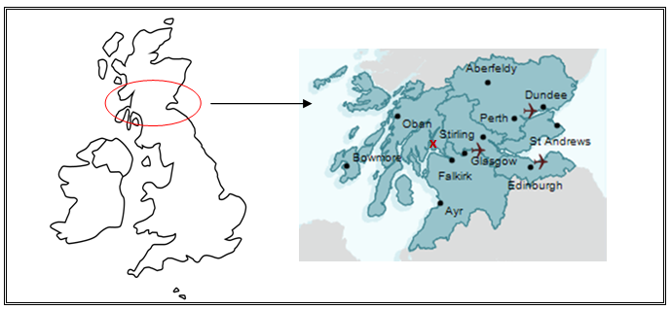
WHO HAS NUCLEAR WEAPONS?
There are almost 200 countries in the world – only 9 choose to have nuclear weapons.
UK's arsenal (over 200 weapons) is based in Scotland at Faslane.
Faslane

Slide 6
nuclear explosions
Blast: Blast wave which destroys buildings.
Heat: Intense heat which causes fires over a wide area.
Immediate radiation:
At the moment of the explosion, deadly radiation affects those in the vicinity.
Radioactive fallout:
Radioactive dust is blown for a long distance downwind of the explosion.

Slide 7
Effects of Nuclear Explosions
Immediate
Vomiting & diarrhoea, tissue damage, blindness, coma & death
Long term
Cancers, particularly in young children and women
Miscarriages, mutations and deformed babies Mental health problems.
Radiation stays in the environment for a very long time and can be carried by wind across oceans and countries.
Notes:
By 1950 over 340,000 people had died as a result of the two bombings.

Slide 8
‘Nuclear Explosions’ video 3 min on USB or online at https://vimeo.com/106861778

Slide 9
NUCLEAR WEAPONS TESTING
Nuclear weapons have been tested on more than 2,000 occasions
Some of the bombs tested were over a thousand times more powerful than the one dropped on Hiroshima.
From 1946 to 1958, the United States conducted 67 tests in the Marshall Islands. If their combined explosive power was parcelled evenly over that 12-year period, it would equal 1.6 Hiroshima-size explosions every single day.

Slide 10
Notes:
Nuclear weapons were tested on more than 2000 occasions, all over the world, majority in some of the most idyllic places on the planet. Did you know that Wick in Caithness was supposed to be a nuclear weapons testing site for the UK?
Back in 1953, as Britain desperately tried to keep up with America and Russia in the nuclear arms race, experts at Aldermaston wanted to test a prototype nuclear bomb at the landmark spot.
Looking at a map of the British Isles, Caithness would have seemed like the ideal spot for such an experiment. The site was then ruled out because the weather was too wet.
The bomb test was eventually carried out in late 1953 at Emu Field, a desert area in South Australia.

Slide 11
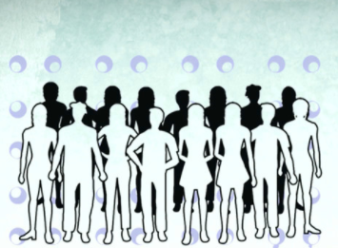
2.4 million people worldwide will eventually die from cancers due to atmospheric nuclear tests

Slide 12
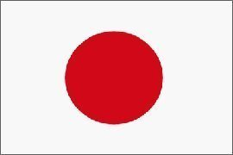
Hiroshima & Nagasaki
6th of Aug, 1945
During WW2, the US drops the first A-bomb on Hiroshima in Japan. Three days later, they drop another on Nagasaki.
The explosions flattened buildings and swept bodies away as well as emitting intense heat (4,000°C) and radiation. Everything within 2 km was completely destroyed and burned.
By 1950 over 340,000 people had died as a result of the two bombings.

Slide 13
Hibakusha (A-BOMB SURVIVORS)
Survivors of the atomic bomb are called Hibakusha.
In addition to the emotional scars from the A-bomb, they also suffer from numerous illnesses considered to be after-effects of the A-bomb.
These illnesses have affected many generations of family members, creating 2nd and 3rd generation Hibakusha.
Hibakusha’s stories are important because they can convey the truth of the tragedies to future generations and counteract the normalisation of nuclear weapons.

Slide 14
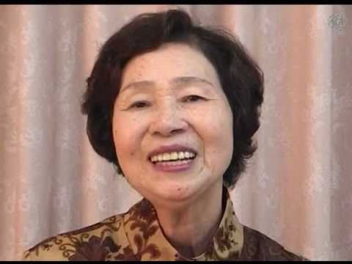
Sueko Takada - Survivor of Nagasaki
She was 6 years old and she developed major health problems considered after-effects of her exposure.
Video section 1 & section 2

Slide 15
Kikue Shiota - HIBAKUSHa
She was 21 years old at the time of the A-bomb.
Her 14 year old sister was killed and her 10 year old brother suffered severe burns. Her mother died suddenly within a month of acute leukaemia. Their house was flattened completely.
Video section 3 & section 4
Notes:
Videos in red are OK to show, but please make sure the teachers approves them before your talk

Slide 16
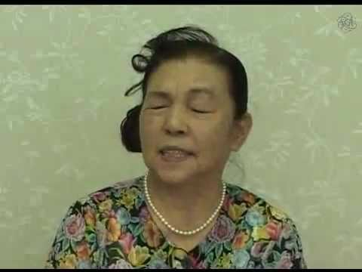
Aiko Kori - Hibakusha
She was 17 at the time of the A-bomb.
She was exposed at the factory where she worked. She was believed to be dead and was almost cremated.
She had leukaemia and her children had health problems. She suffered social stigmatisation and discrimination because of her exposure.
Video section 5 & section 6

Slide 17
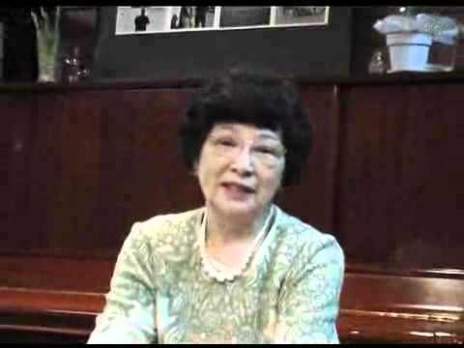
Ayako Kozuka - Survivor of Hiroshima
She was 16 when exposed at her workplace. Soon after "black rain" fell over a wide area. This contained dirt, dust and soot stirred up by the explosion that came into contact with radioactive materials, causing all those exposed to the rain radiation-related conditions. She remained uninjured by the bomb, but ate contaminated tomatoes and this led to a number of illnesses.
Video section 7

Slide 18
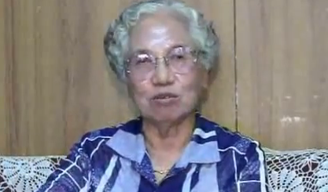
Toyomi Hashimoto - Survivor of Nagasaki
She was 21 and exposed home with her 3 year old son who was blinded by the bombing. She was pregnant and her unborn child was also exposed. Her husband died of illness later leaving her to raise 4 young children. She suffered with Leukopenia (opposite of leukaemia).
Video section 8

Slide 19
Kazumi Niwa Second Generation HIBAKUSHA
She was born a second generation Hibakusha, after her mother was exposed to the A-bomb at Nagasaki.
Both she and her children have suffered from extensive health problems.
Video section 9 & section 10
Notes:
Videos in red are OK to show, but please make sure the teachers approves them before your talk

Slide 20
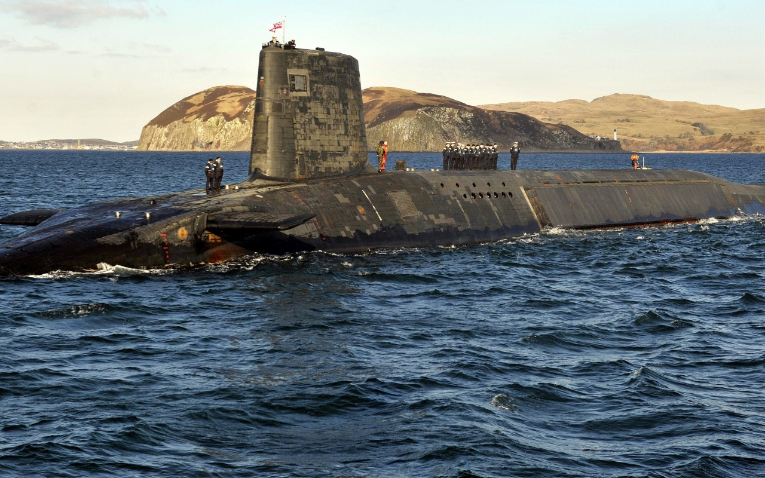
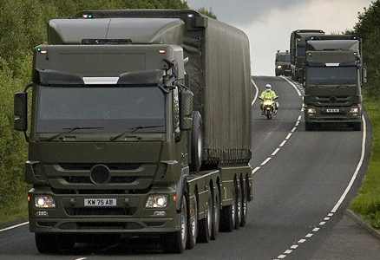
Trident
4 nuclear powered submarines, one continuously on patrol ready to launch at any point

Slide 21
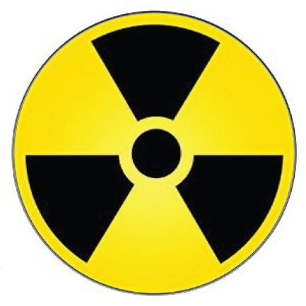
IS TRIDENT LEGAL?
Under international law, a treaty is a legally binding agreement between nations.
In November 1968, the UK signed and ratified the Treaty on the Non-Proliferation of Nuclear Weapons.
On 7th of July 2017, the UN formally adopted a treaty which categorically prohibits nuclear weapons. The United Kingdom has not signed.

Slide 22
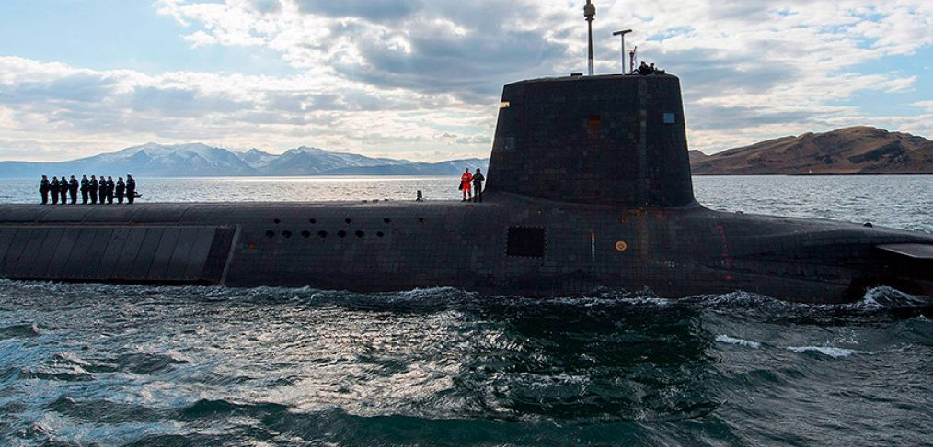
Deterrence
The strategic concept of deterrence aims to prevent war. It is the justification virtually every nuclear state uses for maintaining nuclear arsenals, including the UK.
The concept of nuclear deterrence follows the rationale: states reserve the right to use nuclear weapons in self-defence against an armed attack threatening their vital security interests.
● First Strike policy
● Mutually Assured Destruction (MAD).

Slide 23
DETERRENCE – logically FLAWED
“There has been no other nuclear war, therefore deterrence works”
Logical Fallacy - Affirming the consequent
Logically there is no way to prove that nuclear weapons are the reason we have not had nuclear war. There could be many other reasons for this. The only way to logically ENSURE we cannot have nuclear war is to eradicate nuclear weapons.
In other words:
1. You’re worried it might rain, so you take your umbrella to school for protection.
2. It doesn’t rain.
3. You say “it didn’t rain because I brought my umbrella!”

Slide 24
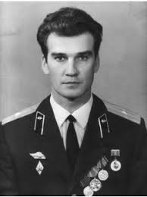
DETERRENCE – DOES IT WORK? “There has been no other nuclear war, therefore deterrence works”
We have come very close to nuclear war several times by intention, malfunction or error.
The late 1900s saw a major nuclear arms-race (particularly between the USA and the Soviet Union). 2018 saw a nuclear arms-race begin to escalate between the USA and North Korea.
In 1983, Stanislav Petrov (lieutenant colonel of the Soviet Air Defence Forces) disobeyed orders to deploy nuclear weapons during a nuclear false alarm. At the height of the cold war, a single nuclear strike would likely have sparked full on nuclear war and the destruction of our planet.
Stanislav is known as “the man who saved the world”.

Slide 25
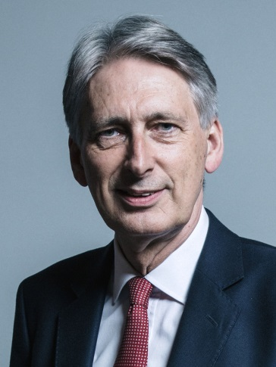
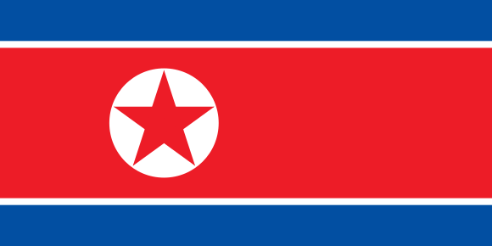
DETERRENCE – do they make us a target? “There has been no other nuclear war, therefore deterrence works”
In 2001 Britain went to war with the nation of Iraq after our leaders told the public that the Iraqi administration were developing WMDs.
In 2016, UK’s foreign Secretary Philip Hammond said “North Korea seem to think possessing a nuclear weapon makes them safe. In fact it’s the opposite. Having a nuclear weapon makes them a target.”

Slide 26
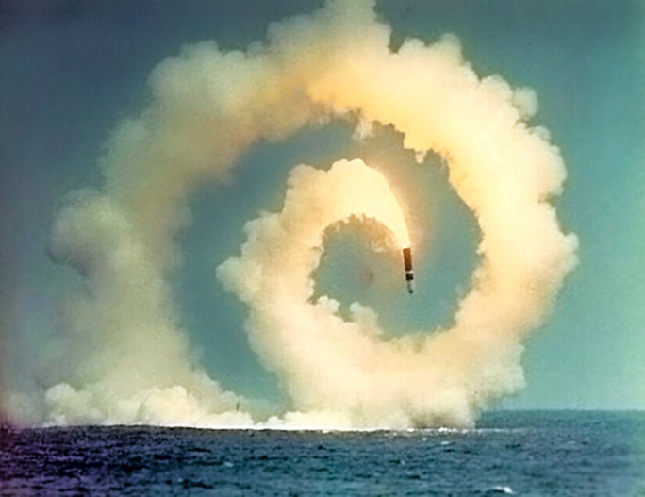
NUCLEAR ACCIDENTS
The MoD has confessed to eight real accidents involving nuclear weapons convoys between 1960s-1990s and 180 safety incidents between 2000-2016
Two years ago, the Royal Navy test-fired an unarmed Trident ballistic missile. This was out by several thousand miles and headed in the opposite direction.

Slide 27
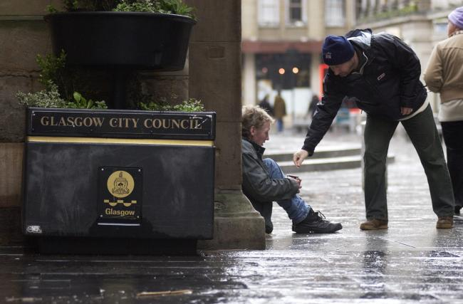
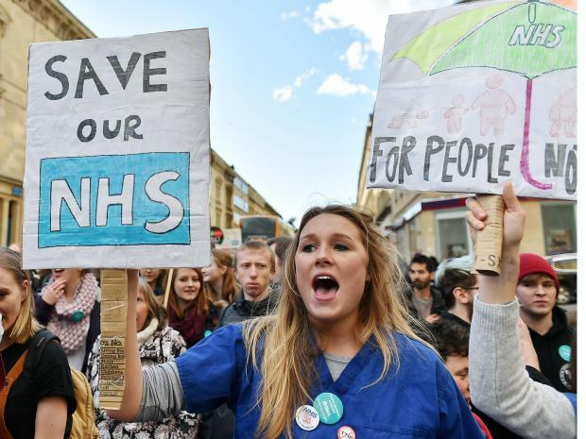
HOW MUCH DO NUCLEAR WEAPONS COST?
Over the next 10 years, world governments will spend a $1 trillion on nuclear weapons globally.
UK alone is set to pay £205 billion to renew our nuclear weapons system

Slide 28
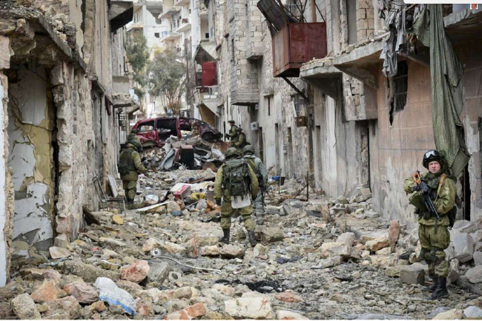
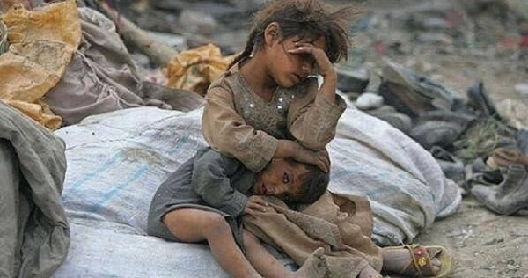
A WORLD AT WAR
There are currently over 40 active conflicts globally.
Nuclear weapons are unsuitable for many modern problems (eg terrorism)
The use of a nuclear weapon in war in 2018 would have a far more devastating effect than Hiroshima or Nagasaki.

Slide 29
Campaign for Nuclear Disarmament
Pressure groups = groups of people who have the same cause and want to change something in their communities and society

Slide 30
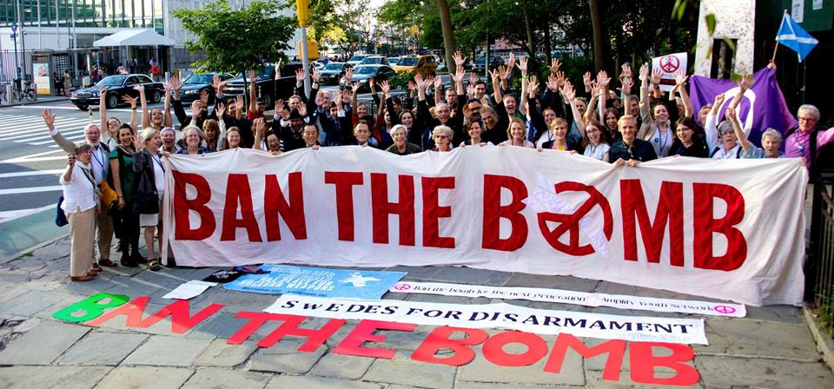
THE TREATY ON THE PROHIBITION OF NUCLEAR WEAPONS
60 signatories countries & 14 state parties
An example on how a grass-root movement can shift the power to civil society in the modern world.

Slide 32
ICAN video
“If you love this planet” 4 min 30 sec on USB
or online at https://vimeo.com/245838745

